Slide 1
Pandiyan Murugan
Senior Software Engineer
Building & Publishing an angular library to npm

Slide 2


Slide 3


Slide 4

Quick solution

Slide 5
Quality of a package
Work with AOT
Properly bundled and distributed
Platform independent
Work well with Typescript (compile time checking)
Tree shakeable, dead code elimination

Slide 6

Angular Package Format

Slide 7
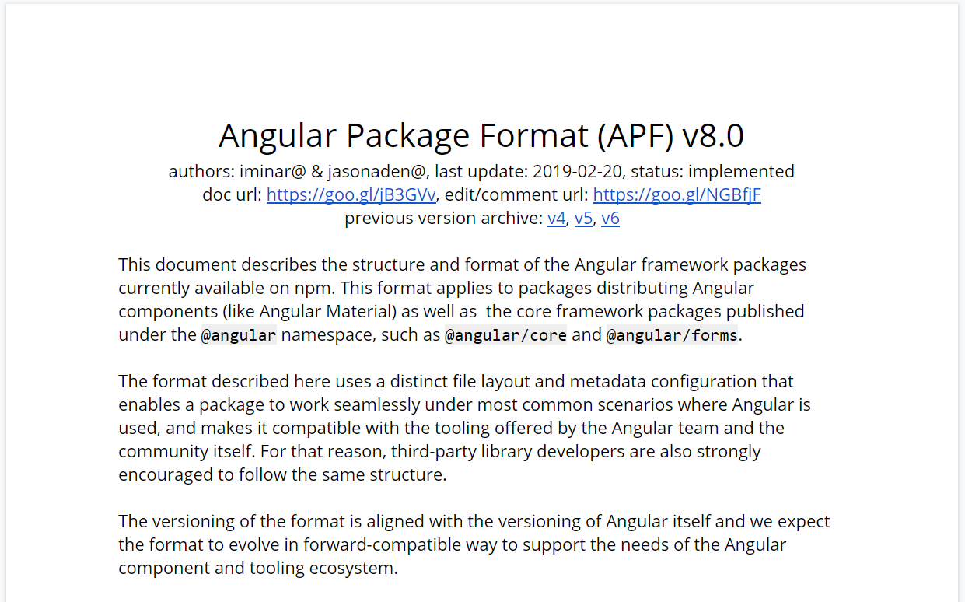

Slide 8

Angular Package Format Document
Set of guidelines & best practices
Describes distinct file layout & metadata configuration
Enables to work seamlessly under common scenarios

Slide 9





Usage scenarios & environments
WebPack (optimized) / Closure Compiler
Plunker / Fiddle / ES5 / script tag
Node.js
TypeScript
AOT compilation

Slide 10
Build / Bundler / Consumer | Module Format | Primary Entry Point resolves to | Secondary Entry Points resolves to
WebPack (optimized) / Closure Compiler | ESM+ ES2015 (flattened) | fesm2015/core.js | fesm2015/testing.js
CLI / Rollup / WebPack | ESM+ES5 (flattened) | fesm5/core.js | fesm5/testing.js
WebPack v4 (optimized) | ESM+ ES2015 | esm2015/core.js | esm2015/testing/testing.js
WebPack v4 | ESM+ ES5 | esm5/core.js | esm5/testing/testing.js
Plunker / Fiddle / ES5 / script tag | UMD | Requires manual resolution by the developer to: bundles/core.umd.js and bundles/core.umd.min.js | Requires manual resolution by the developer to: bundles/core-testing.umd.js
Node.js | UMD | bundles/core.umd.js | bundles/core-testing.umd.js
TypeScript | ESM+d.ts | core.d.ts | testing/testing.d.ts
AOT compilation | .metadata.json | @angular/core/core.metadata.json | @angular/core/testing.metadata.json

Slide 11
Demo

Slide 12
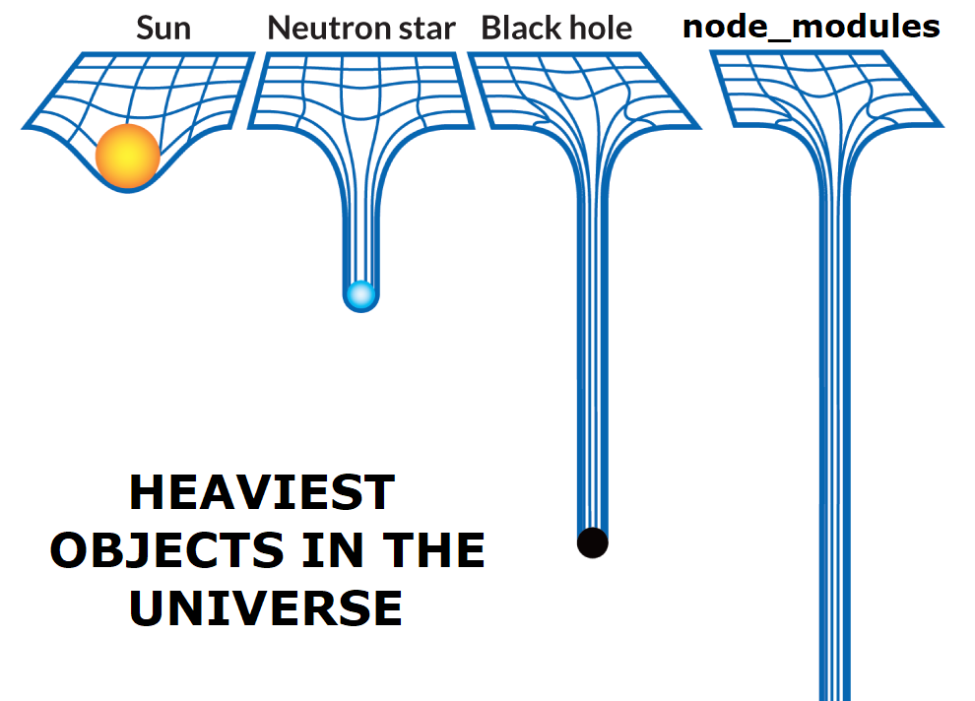

Slide 13

npm package?

Slide 14


Thanks, Keep supporting ☺
Subscribe to Efficient User
and click the bell icon.
Developer blogs
efficientuser.com
nullablereference.wordpress.com

